Slide 1

Paradise: Designing Perfect Worlds
Ben Cook
Notes:
See this link for the video presentation: https://www.youtube.com/watch?v=uuBW6GNJXGk

Slide 2
“Traditional” Standards of Evolution

Slide 3

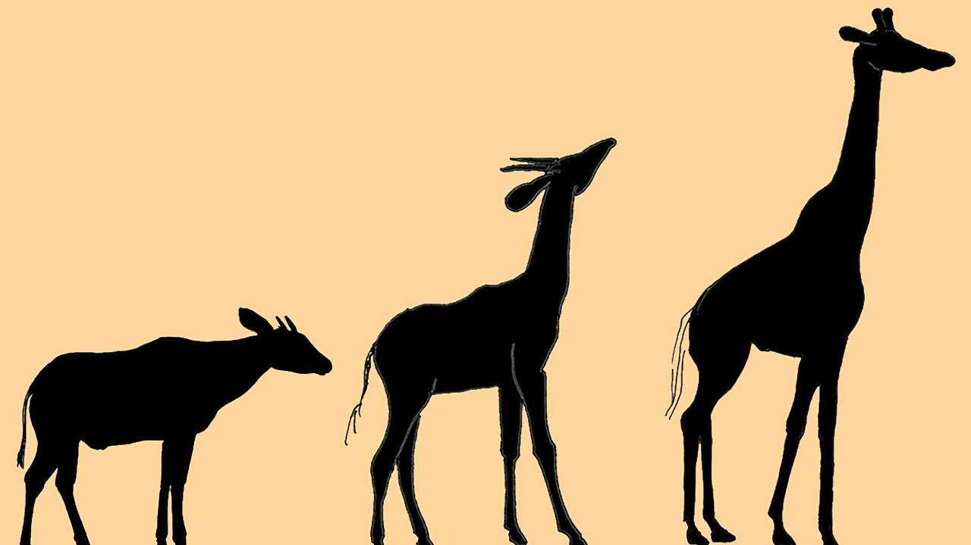
Creature Adapts Environment

Slide 5
”Traditional” Evolution
(Relatively) static worlds with dynamically adapting creatures:
Animals evolve using:
Selection
Pick the best suited creatures
Breeding (crossover)
Combine parts of these best suited creatures
Mutation
Change small parts randomly

Slide 6
Creature Adapts Environment

Slide 7
“Terraforming”

Slide 8
Goal: Design a Perfect World For a Creature
Use the same methods as traditional evolution:
Selection
Pick the best suited world
Breeding (crossover)
Combine parts of these best suited worlds
Mutation
change small parts of the worlds
Based on static creatures

Slide 9
Implementation
Netlogo’s “LevelSpace” extension
Allows one simulation to run multiple others, and give/receive information
Each ”Generation”
Generate “n” worlds each with “k” creatures in each
All worlds are simulated for some time
Return the world and its evaluation function to the Master sim
Run the genetic algorithm on the worlds to make new ones
Repeat for x generations
In the end we should arrive at a “perfect world”

Slide 10
Master Sim
-Handles the Genetic Algorithm
(Making new world layouts)
Returns world layout and evaluation of how ”good” it is.
Creates ”n” worlds each generation
Process repeats for “x” generations until we have a perfect world
Single world 0
-Simulates creatures
Single world
-Simulates creatures
Single world 2
-Simulates creatures
Single world N
-Simulates creatures
. . .

Slide 11
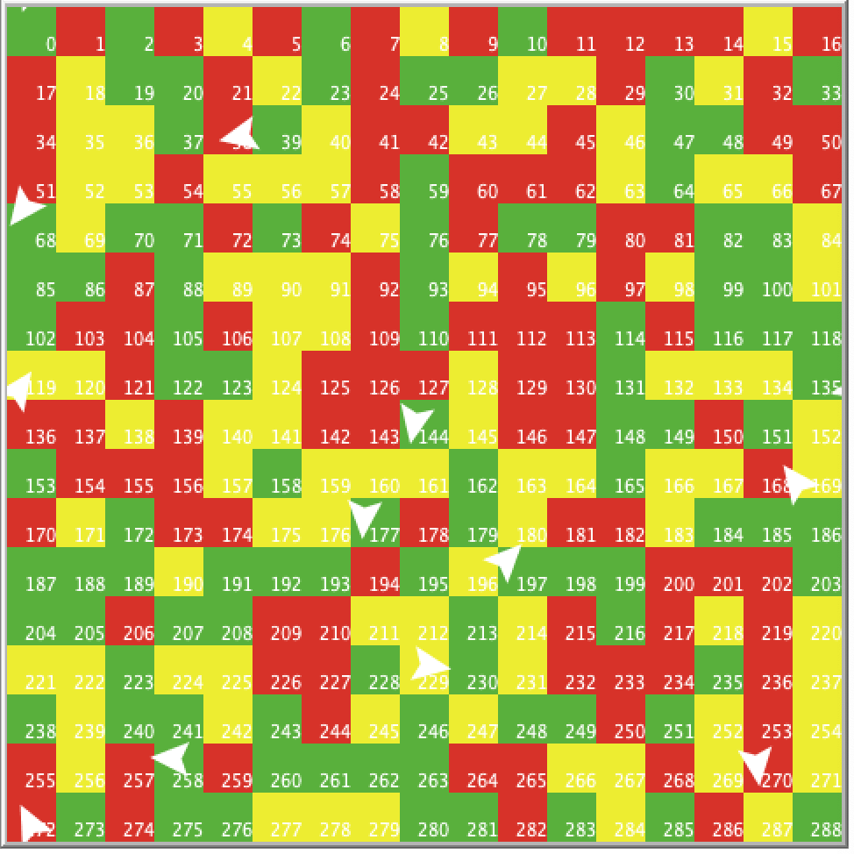
Simplified World and Creature Model
Creatures:
Can Move (randomly)
Get Energy from different foods (3 kinds)
The exact amount can be changed
Lose energy after each move
Die if they lose too much energy
Reproduce if they reach a certain energy threshold
Worlds:
Simple 2D array of colored squares
Each square represents a particular food type based on color

Slide 12
Genetic algorithm “Master Sim”
Generations a population of random boards to begin, and creates child simulations
Receives the worlds back, along with their evaluation function and sorts them
Selects the top two worlds:
Uses a “roulette-based" selection method
Based on the average “Turtles-per-tick” of a world
“Breeds them” by picking two random indices i₁ and i₂ to create a new “child” world
Takes the world from parent 1 when “outside” (less or greater)
Takes the world from parent 2 when “between”
”Mutates” this child randomly based on mutation rate
Each Gene (square in world) has a chance to change based on the mutation rate

Slide 13
Parameters
Single Sim:
NumStart: number of animals initially placed in the world
Energy0: Energy from eating Green
Energy1: Energy from eating Red
Energy2: Energy from eating Yellow
EnergyLossPerMove: amount of energy lost after moving
Master Sim:
Roulette Factor: The amount of randomness in the selection function
Mutation rate: The chance that a particular gene has to mutate

Slide 14

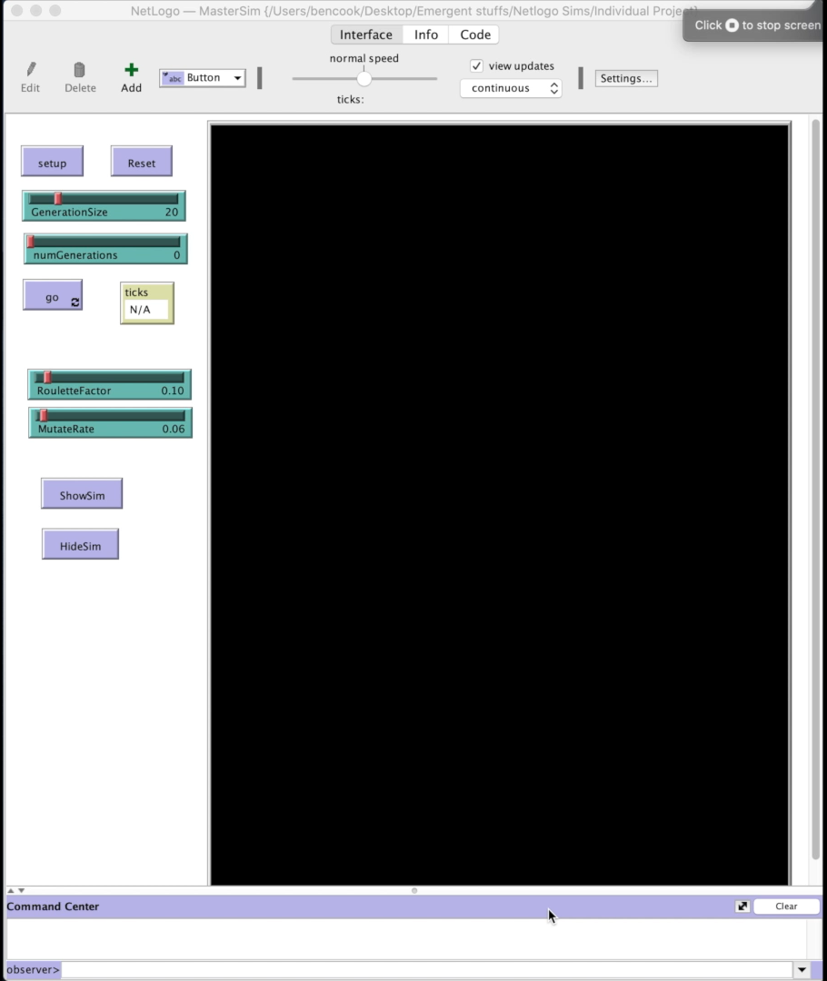
Example Run: “Red Food”

Slide 15
Experiment ”4”: Inefficient Creatures
Goal: Develop a perfect world for a creature that is barely able to sustain itself
Parameters:
Energy 0: -1
Energy 1: 40
Energy 2: -38
LossPerMove 1

Slide 16
Results
31.9 Turtles per Tick 132.25 Turtles per Tick 187.67 Turtles per Tick
80 gens
100 gens

Slide 17
Conclusion
Overall the project was a success on this very simplified model
Is a proof of concept that using a genetic algorithm to ”terraform” worlds to fit creatures is a valid solution
Requires more complexity elements in the creatures as the next step

Slide 18
Future Work
Urges towards certain foods (even if the food may not be optimal)
Terrain types
Water, rocks, dirt
Different energy expenditures/speeds for each type
Overpopulation mechanics
Predator and prey mechanics

